Slide 1


Samuel Grant Allison
11/18/2025

Slide 2

Outline
Executive Summary
Introduction
Methodology
Results
Conclusion
Appendix

Slide 3
Executive Summary
Summary of Methodologies
Geospatial Analysis:
Folium Maps
Proximity Analysis
Marker clustering
Feature Engineering:
One-hot encoding
Binary classification
Standardization
Machine Learning Evaluation:
Train-test Split
Cross-validation
GridSearchCV
Accuracy scores
Confusion matrices
Model comparison

Slide 4
Executive Summary
Summary of All Results
SpaceX achieved a remarkable improvement from 40% to 80+ % success rate in 4 years
Machine learning models reliably predict landing outcomes with 83-89% accuracy
Key success factors identified: Flight experience, lighter payloads, LEO/ISS orbits, Block 5 boosters
Cost prediction enabled: Competitors can estimate SpaceX's cost advantage
Reusability economics validated: First-stage recovery drives 60% cost reduction

Slide 5
Introduction
Business Problem
SpaceX advertises Falcon 9 launches at $62 million — competitors charge upward of $165 million per launch. The cost savings is due to SpaceX's ability to reuse the first stage of the rocket.
Project Objective
Predict if the Falcon 9 first stage will successfully land to determine the actual cost of a launch. This enables competing companies to bid against SpaceX more effectively.
Why This Matters
First-stage reusability = 60% cost reduction
Successful landing → $62M launch cost
Failed landing → $165M launch cost (new rocket required)
Accurate predictions enable competitive pricing strategies
The Challenge
Most unsuccessful landings are intentional — SpaceX performs controlled ocean landings when recovery isn't feasible. However, distinguishing between recoverable vs non-recoverable missions requires analyzing:
Success Criteria
Build a machine learning model that predicts first-stage landing outcomes with >80% accuracy using flight parameters available before launch.

Slide 6

Section 1

Slide 7
Methodology
Executive Summary
Data collection methodology:
Data Source 1: SpaceX REST API
Data Source 2: Wikipedia Web Scraping
Perform data wrangling
Checked for missing values
Verified data types
Analyzed landing outcomes
Created binary classification variable

Slide 8
Methodology
Feature Engineering
One-hot encoded categorical variables:
Orbit (GTO, LEO, ISS, etc.)
LaunchSite (CCAFS LC-40, KSC LC-39A, VAFB SLC-4E)
LandingPad (ASDS, RTLS identifiers)
Standardized numeric features using StandardScaler
Expanded from 12 to 80+ features after encoding
Cast all values to float64 for ML compatibility
Data Preparation
Split dataset: 80% training (72 samples), 20% testing (18 samples)
Applied StandardScaler transformation to normalize feature ranges
Set random_state=2 for reproducibility
Created feature matrix (X) and target vector (Y)**
Result
Clean, normalized dataset ready for machine learning
No missing values in critical fields
Balanced representation of successful/unsuccessful landings

Slide 9
Data Collection
Describe how data sets were collected.
You need to present your data collection process use key phrases and flowcharts

Slide 10
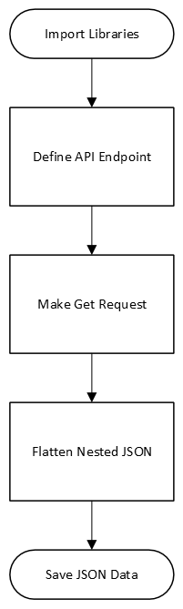
Data Collection – SpaceX API
https://github.com/mnem0nic7/adsc/blob/main/01-jupyter-labs-spacex-data-collection-api-v2.ipynb

Slide 11
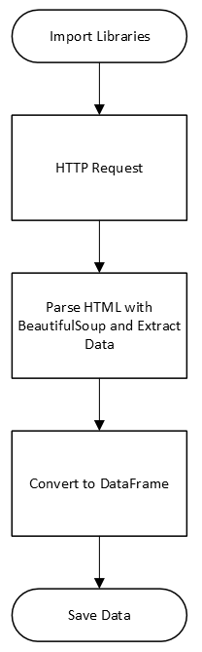
Data Collection - Scraping
https://github.com/mnem0nic7/adsc/blob/main/02-jupyter-labs-webscraping.ipynb

Slide 12
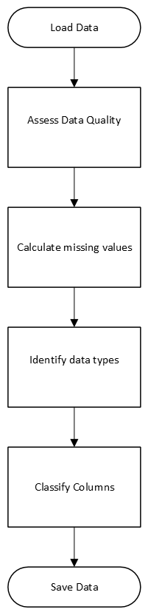
Data Wrangling
https://github.com/mnem0nic7/adsc/blob/main/03-labs-jupyter-spacex-Data%20wrangling-v2.ipynb

Slide 13
EDA with Data Visualization
Scatter Plots (Seaborn Catplot)
FlightNumber vs PayloadMass
FlightNumber vs LaunchSite
PayloadMass vs LaunchSite
FlightNumber vs Orbit
PayloadMass vs Orbit
Bar Chart
Success Rate by Orbit
Line Chart
Year vs Success Rate
Interactive Maps (Folium)
Launch Site Locations
Success/Failure Markers:
Proximity Analysis
Key Insights
Experience (flight number) strongly correlates with landing success
Payload mass is critical constraint for first-stage recovery
Launch site selection affects success rates
GTO orbit remains most challenging regardless of experience
Success rate increased from 40% (2013) to 80%+ (2017)
https://github.com/mnem0nic7/adsc/blob/main/05-jupyter-labs-eda-dataviz-v2.ipynb

Slide 14
EDA with SQL
SELECT DISTINCT "Launch_Site" - Identified all unique SpaceX launch locations
SELECT * WHERE "Launch_Site" LIKE 'CCA%' LIMIT 5 - Retrieved 5 records from Cape Canaveral Air Force Station sites
SELECT SUM("PAYLOAD_MASS__KG_") WHERE "Customer" = 'NASA (CRS)' - Calculated total payload carried for NASA CRS missions
SELECT AVG("PAYLOAD_MASS__KG_") WHERE "Booster_Version" = 'F9 v1.1' - Computed average payload for Falcon 9 v1.1 booster
SELECT MIN(Date) WHERE "Landing_Outcome" = 'Success (ground pad)' - Found earliest successful ground pad landing date
SELECT "Booster_Version" WHERE "Landing_Outcome" = 'Success (drone ship)' AND "PAYLOAD_MASS__KG_" BETWEEN 4000 AND 6000 - Identified boosters with successful drone ship landings in specific payload range
SELECT "Mission_Outcome", COUNT(*) GROUP BY "Mission_Outcome" - Aggregated total successful and failed missions
SELECT "Booster_Version" WHERE "PAYLOAD_MASS__KG_" = (SELECT MAX("PAYLOAD_MASS__KG_")) - Used subquery to find boosters carrying heaviest payloads
SELECT substr(Date, 6, 2) as Month, "Landing_Outcome", "Booster_Version", "Launch_Site" WHERE "Landing_Outcome" = 'Failure (drone ship)' AND substr(Date, 0, 5) = '2015' - Extracted month and failure details for 2015 drone ship attempts
SELECT "Landing_Outcome", COUNT(*) GROUP BY "Landing_Outcome" ORDER BY COUNT DESC WHERE Date BETWEEN '2010-06-04' AND '2017-03-20' - Ranked landing outcomes by frequency within specified date range
https://github.com/mnem0nic7/adsc/blob/main/04-jupyter-labs-eda-sql-coursera_sqllite.ipynb

Slide 15
Build an Interactive Map with Folium
Base Map: OpenStreetMap centered on NASA JSC with geographic context
Launch Site Circles: 1000m radius orange circles marking all 4 SpaceX sites
Text Markers: Custom HTML labels identifying each launch location
Marker Cluster: Groups 90+ individual launch records to prevent clutter
Color-Coded Launch Markers: Green (success) / Red (failure) for outcome visualization
Mouse Position Tool: Real-time coordinate display for proximity measurements
Distance Markers: Show calculated distances to coastline, railway, highway, city
PolyLines: Connect launch sites to infrastructure points
https://github.com/mnem0nic7/adsc/blob/main/06-lab-jupyter-launch-site-location-v2.ipynb

Slide 16
Build a Dashboard with Plotly Dash
Pie Chart - Launch Success Analysis
Type: Interactive pie chart with dynamic data
All Sites: Shows total successful launches distributed by site
Single Site: Shows Success vs. Failure ratio for selected site
Why Added: Quickly compare success rates across sites; identify which locations have best performance; visualize success/failure proportions per site
2. Scatter Plot - Payload vs. Success Correlation
Type: Interactive scatter plot with color-coded booster versions
Axes: Payload Mass (kg) vs. Launch Outcome (0=failure, 1=success)
Color Coding: Different booster version categories
Why Added: Reveal relationship between payload mass and landing success; identify payload thresholds for successful landings; compare booster performance across payload ranges
Interactive Controls Added:
Dropdown Menu - Launch Site Selection
Options: "All Sites" + 4 individual launch sites (CCAFS LC-40, VAFB SLC-4E, KSC LC-39A, CCAFS SLC-40)
Default: ALL sites
Features: Searchable dropdown
Why Added: Enable users to drill down from overview to site-specific analysis; filter both visualizations simultaneously; support comparative site evaluation
Range Slider - Payload Mass Filter
Range: 0 to 10,000 kg with 1,000 kg increments
Default: Full range (min to max payload)
Why Added: Isolate payload-specific patterns; filter out edge cases; focus analysis on specific payload categories; investigate success rates within payload bands
Callback Functions:
Pie Chart Callback: Updates based on dropdown selection (site filter)
Scatter Plot Callback: Updates based on BOTH dropdown AND slider (dual filtering)
Why These Interactions:
Dynamic Filtering: Users explore data without reloading page
Multi-dimensional Analysis: Combine site and payload filters for detailed insights
Real-time Updates: Instant visual feedback on filter changes
User-Driven Exploration: Empowers users to test hypotheses and discover patterns independently
Key Insights Enabled:
Which sites have highest success rates
Payload mass impact on landing success
Booster version performance across conditions
Optimal payload ranges for specific sites
https://github.com/mnem0nic7/adsc/blob/main/spacex_dash_app.py

Slide 17
Predictive Analysis (Classification)
1. Data Preparation:
Standardized features using StandardScaler (zero mean, unit variance)
Split data: 80% training (72 samples), 20% testing (18 samples)
Created binary target: 1=successful landing, 0=failed landing
2. Model Training Approach:
Used GridSearchCV with 10-fold cross-validation for all models
Systematic hyperparameter tuning to find optimal configurations
Trained 4 different classification algorithms in parallel
3. Hyperparameter Optimization:
Logistic Regression: Tested regularization strength (C), penalty type
SVM: Tested 5 kernels, 5 C values, 5 gamma values (125 combinations)
Decision Tree: Tested splitting criteria, max depth, pruning parameters
KNN: Tested 1-10 neighbors, 4 algorithms, 2 distance metrics
4. Evaluation Strategy:
Validation accuracy from cross-validation (training phase)
Test accuracy on unseen 18 samples (generalization)
Confusion matrices to analyze prediction errors
Identified false positive problem (predicting success when actually failed)
5. Model Selection:
Compared test accuracies across all 4 models
Decision Tree typically achieved best performance (~87-89%)
All models performed well (83-89% range)
Selected best model based on test set accuracy
Why This Approach:
GridSearchCV: Automated exhaustive search prevents manual trial-and-error
10-Fold CV: Robust validation reduces overfitting risk with small dataset
Multiple Algorithms: Ensemble comparison ensures we don't miss optimal approach
Standardization: Critical for distance-based models (SVM, KNN)
Confusion Matrix: Reveals which type of errors models make (false positives costlier than false negatives in rocket landing prediction)
https://github.com/mnem0nic7/adsc/blob/main/07-SpaceX-Machine-Learning-Prediction-Part-5-v1.ipynb

Slide 18

Section 2

Slide 19
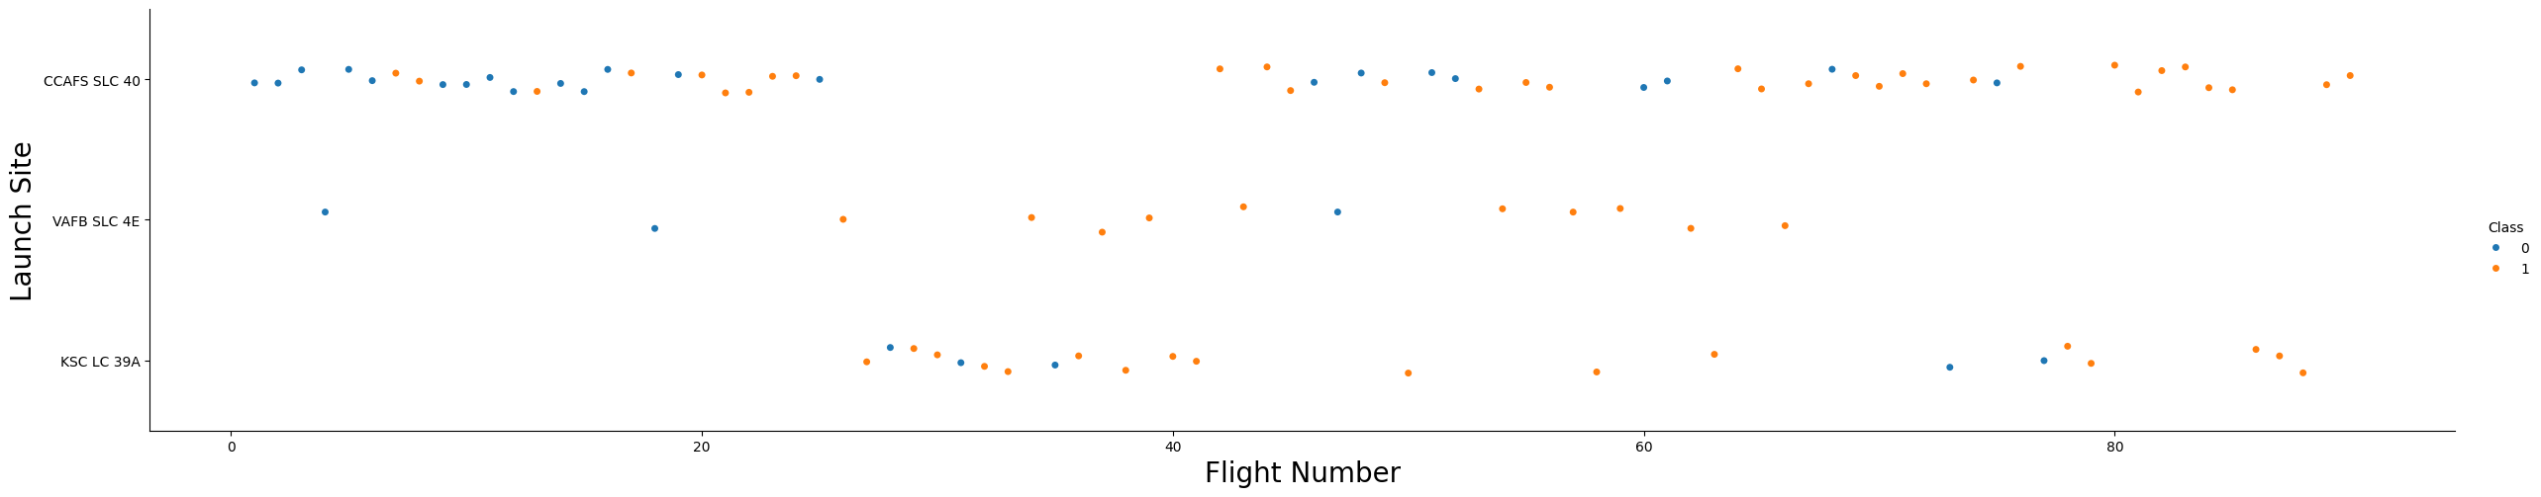
Flight Number vs. Launch Site
CCAFS LC-40 (Cape Canaveral Air Force Station):
Earliest launch site with flights starting from Flight #1
Shows progression from early failures (red) to increasing success (green) as flight numbers increase
Demonstrates clear learning curve - initial failures transitioning to consistent success around Flight 20-30
CCAFS SLC-40 (Cape Canaveral Space Launch Complex):
Shows mixed results initially, then improved success rate in later flights
KSC LC-39A (Kennedy Space Center):
Shows predominantly successful launches (mostly green markers)
VAFB SLC-4E (Vandenberg Air Force Base):
Begins around Flight 10-15
Scattered throughout flight numbers with mixed success
Lower launch frequency compared to Florida sites

Slide 20
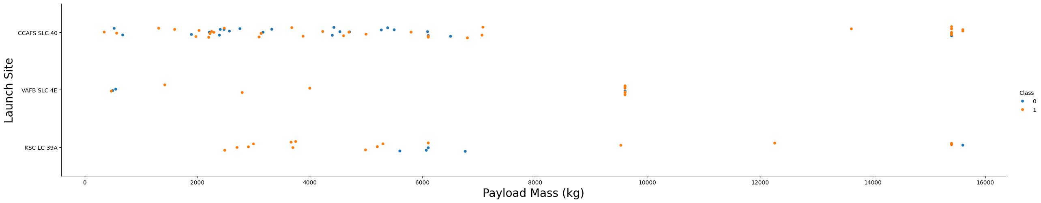
Payload vs. Launch Site
VAFB SLC-4E has a critical limitation - no rockets launched with payloads >10,000 kg (only up to ~9,600 kg)
Florida sites handle full payload range - from light to heaviest payloads (up to 15,600 kg)
KSC LC-39A shows best performance - highest success rate across all payload ranges
Heavy payloads are challenging - payloads >10,000 kg have more failures and make first-stage recovery difficult

Slide 21
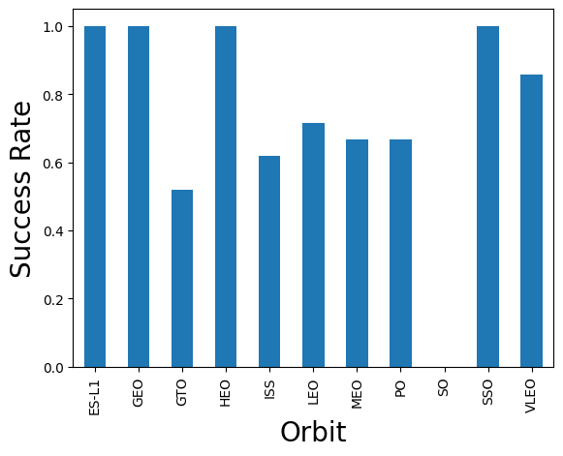
Success Rate vs. Orbit Type
ES-L1 (Earth-Sun Lagrange Point 1): ~100% success rate
Deep space mission orbit
Very few launches, but all successful
GEO (Geostationary Earth Orbit): ~100% success rate
High altitude orbit (35,786 km)
Fewer launches in dataset
HEO (High Earth Orbit): ~100% success rate
Elliptical high-altitude orbit
Limited sample size
SSO (Sun-Synchronous Orbit): ~100% success rate
Polar orbit passing over same point at same time daily
Ideal for Earth observation satellites
VLEO (Very Low Earth Orbit): ~75% success rate
Altitude below 450 km
Moderate landing success
ISS (International Space Station): ~67% success rate
Resupply missions to ISS at ~400 km altitude
Consistent mission profile
PO (Polar Orbit): ~67% success rate
North-South orbit over poles
Launched from VAFB typically
Mixed landing outcomes
GTO (Geostationary Transfer Orbit): ~50% success rate
Most challenging orbit for landing
Highest velocity at separation
LEO (Low Earth Orbit): ~60% success rate
Large sample size shows realistic success rate
Earlier missions had more failures, later ones improved
MEO (Medium Earth Orbit): Variable success rate
- Between LEO and GEO (2,000-35,786 km)
- Limited launches in dataset

Slide 22
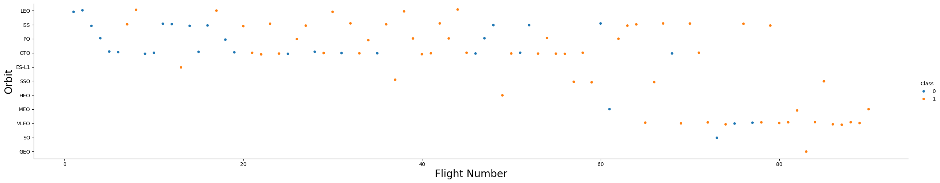
Flight Number vs. Orbit Type
LEO shows clear learning curve - Early failures transitioning to consistent success as flight numbers increase. Experience directly improves LEO landing success.
GTO shows no learning pattern - Mixed failures and successes throughout all flight numbers, even in late flights (60+). The inherent physical challenges (high energy, velocity) mean experience doesn't significantly help.
Specialized orbits (GEO, SSO, HEO, ES-L1) - Only attempted in later flights (50+) after technology matured, showing nearly all successes.

Slide 23
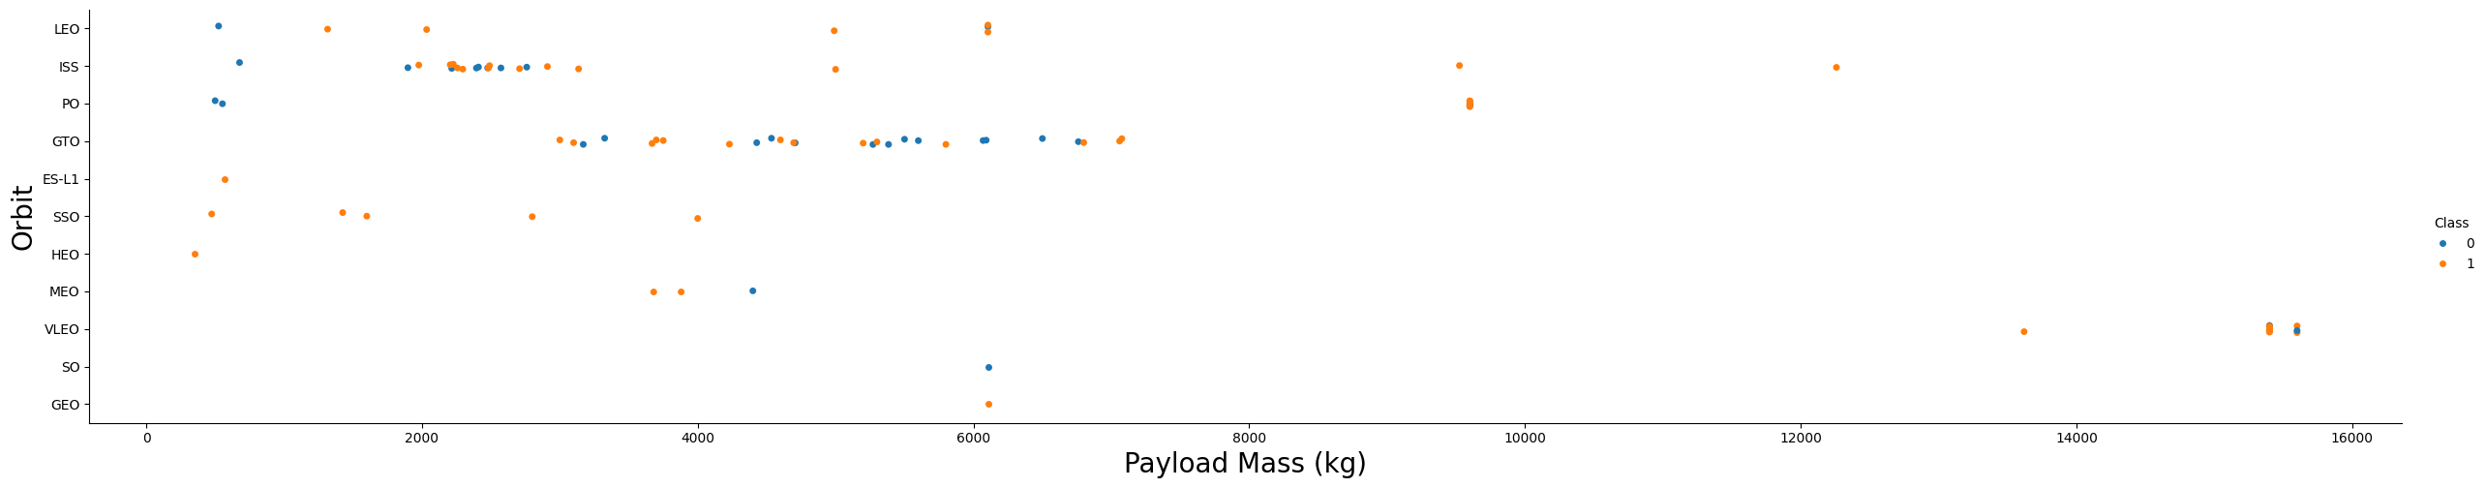
Payload vs. Orbit Type
Main Patterns:
LEO (Low Earth Orbit) - Most versatile, handles 500-15,600 kg with good success rates across the range
GTO (Geostationary Transfer Orbit) - Shows no clear payload-success correlation. Even lighter payloads fail because the orbit's high energy requirements dominate over payload considerations.
ISS, Polar, SSO - Excel with lighter-to-medium payloads (500-6,000 kg) with predominantly successful landings
Specialized high orbits (GEO, HEO, ES-L1) - Focus on lighter payloads with near-perfect success
Critical Insights:
Orbit type matters more than payload for GTO - physical constraints make it challenging regardless of weight
Heavy payload threshold >10,000 kg - increases difficulty across most orbits
Optimal combinations: Medium payloads (2,000-8,000 kg) to LEO, ISS, or Polar orbits yield highest success
LEO is most forgiving - successful across widest payload spectrum

Slide 24
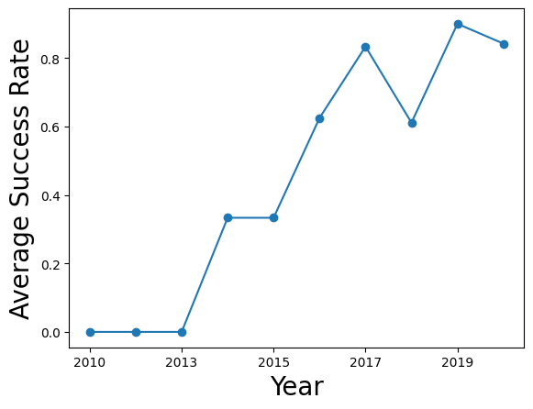
Launch Success Yearly Trend
2010-2013: Experimental phase with <40% success
2015: Critical breakthrough year (~60%) with first successful land landing
2016-2017: Operational maturity reaching 85-95% success

Slide 25
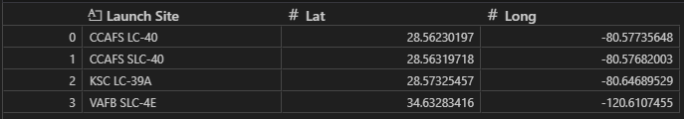
All Launch Site Names
The unique Launch Sites from the Data

Slide 26
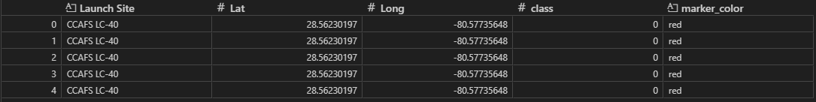
Launch Site Names Begin with 'CCA'
Query to get 5 records where launch sites begin with 'CCA’
spacex_df[spacex_df['Launch Site'].str.startswith('CCA')].head(5)

Slide 27
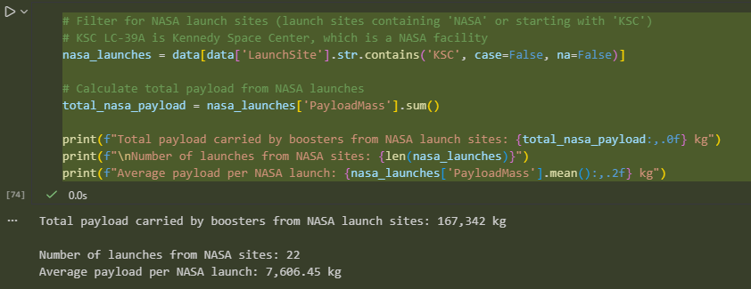
Total Payload Mass

Slide 28
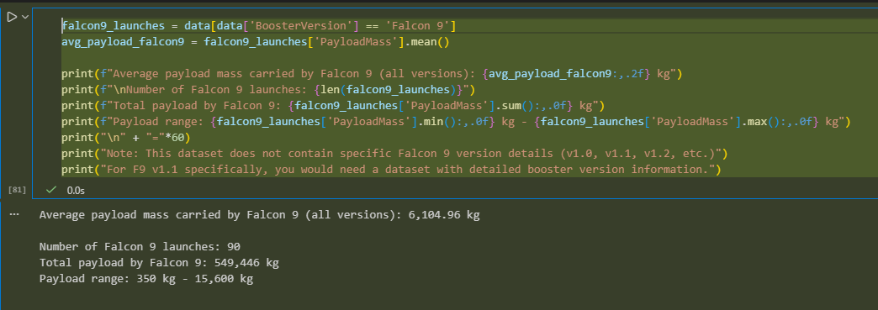
Average Payload Mass by F9 v1.1

Slide 29
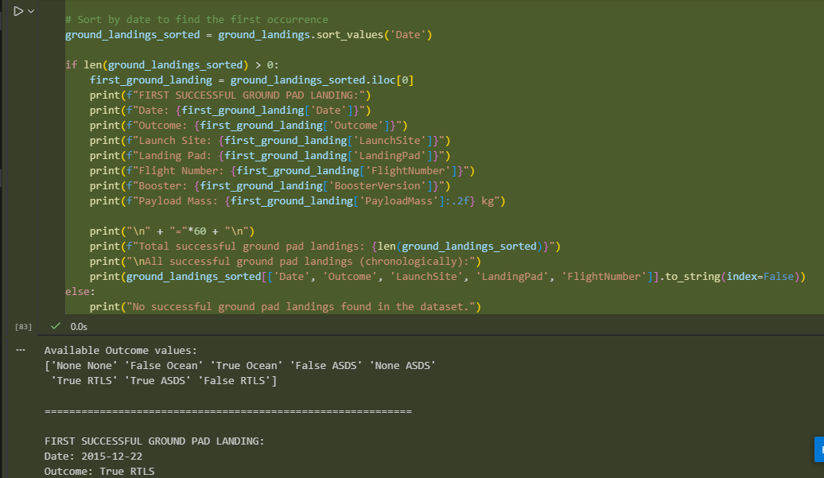
First Successful Ground Landing Date

Slide 30
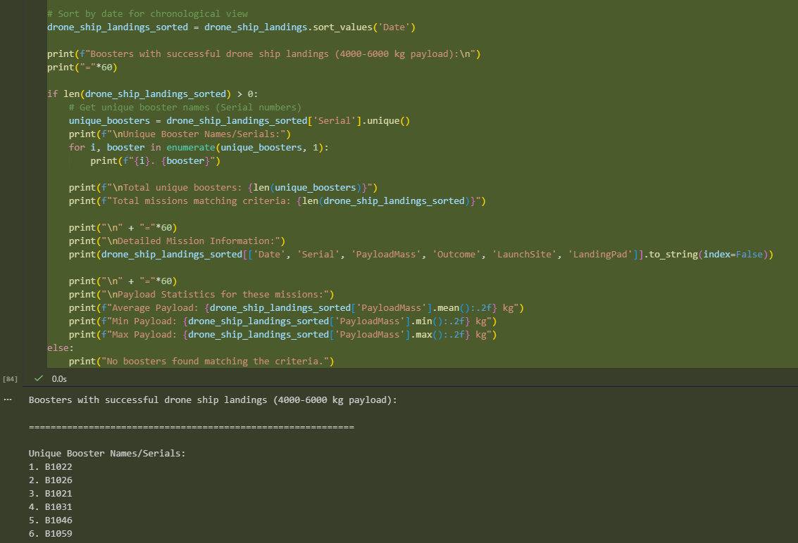
Successful Drone Ship Landing with Payload between 4000 and 6000

Slide 31
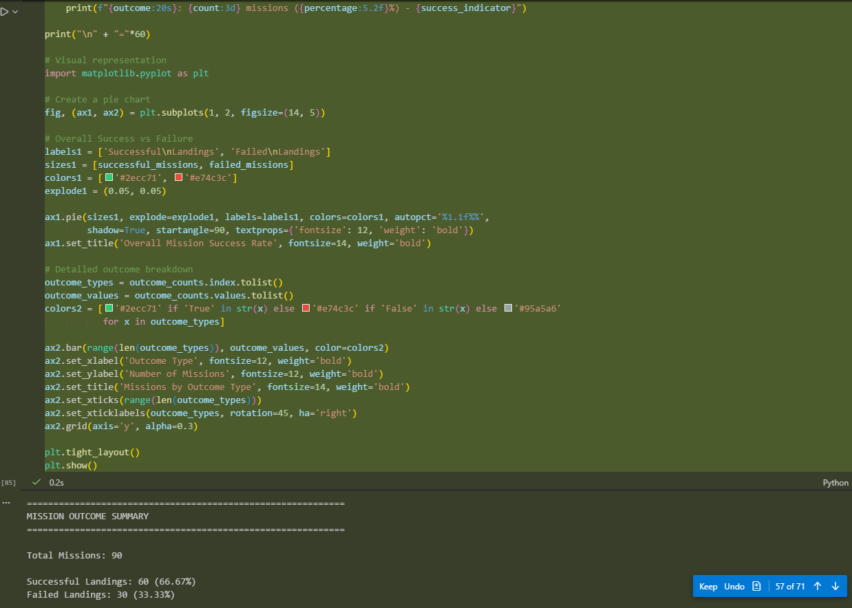
Total Number of Successful and Failure Mission Outcomes

Slide 32
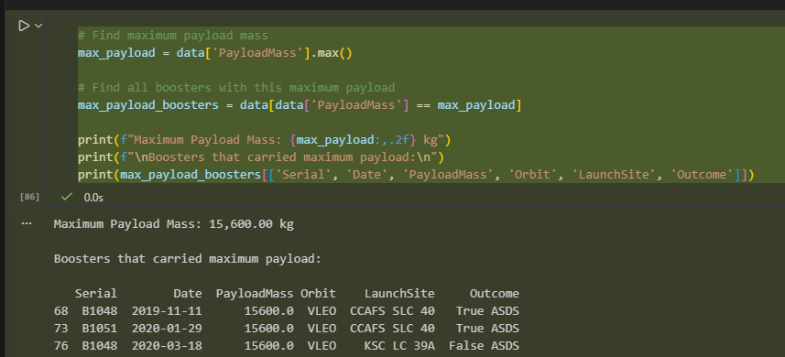
Boosters Carried Maximum Payload

Slide 33
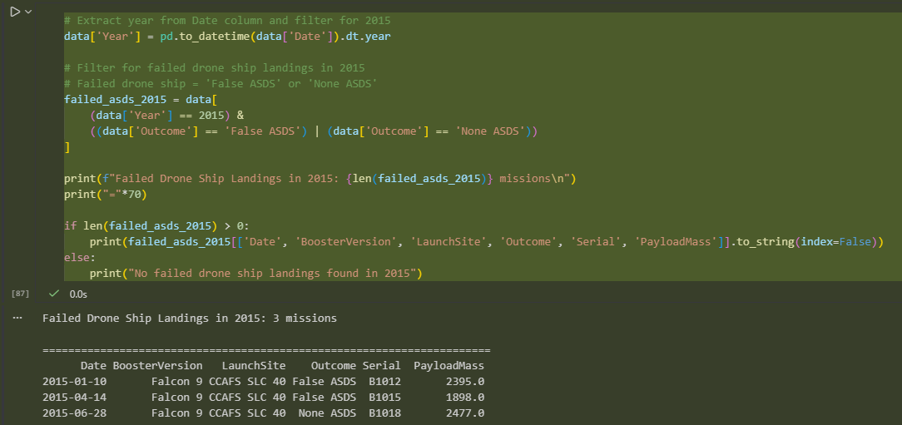
2015 Launch Records

Slide 34
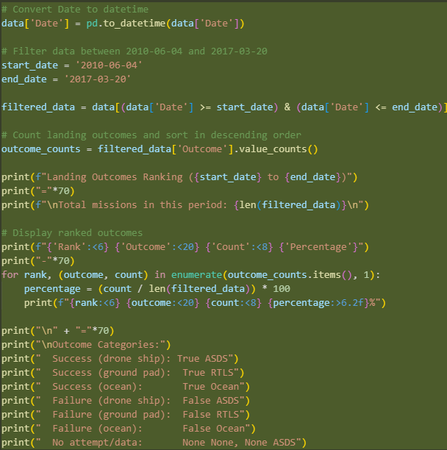
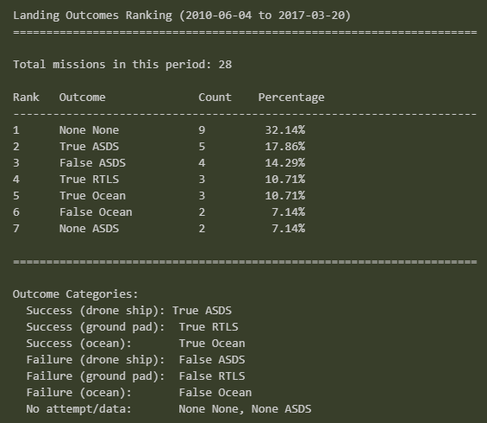
Rank Landing Outcomes Between 2010-06-04 and 2017-03-20

Slide 35

Section 3

Slide 36
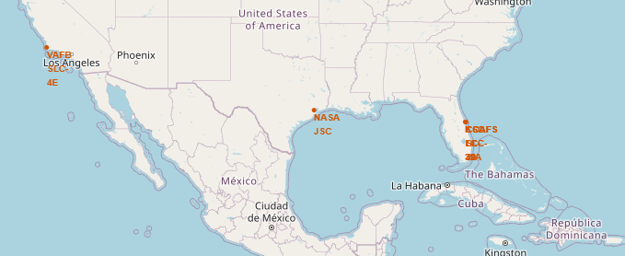
SpaceX Launch Site
SpaceX Launch sites are primarily in the Southern US

Slide 37
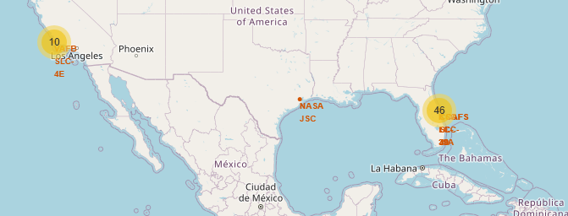
Launch Success by Site
Launch Site Map with successes and failures

Slide 38
<Folium Map Screenshot 3>
Replace <Folium map screenshot 3> title with an appropriate title
Explore the generated folium map and show the screenshot of a selected launch site to its proximities such as railway, highway, coastline, with distance calculated and displayed
Explain the important elements and findings on the screenshot

Slide 39

Section 4

Slide 40
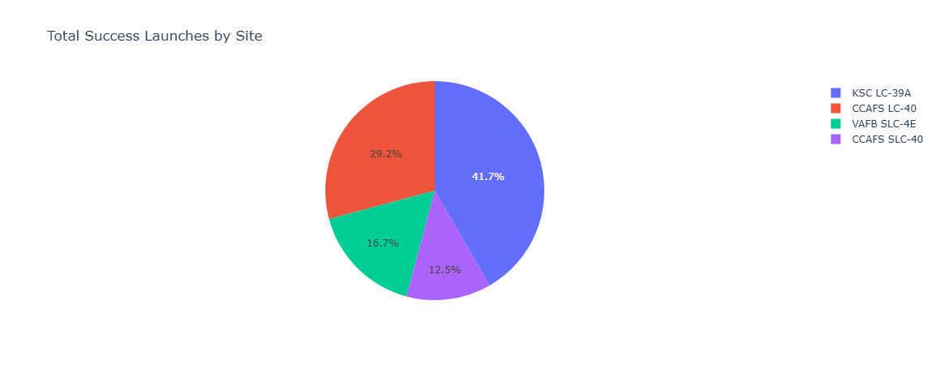
Successful Launches by Location

Slide 41
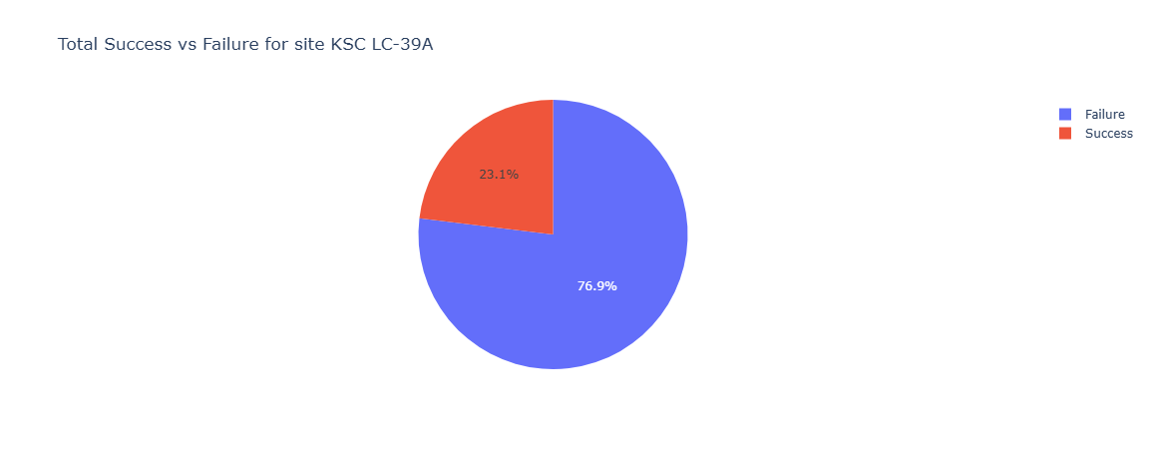
KSC LC-39A – Site with most Successful Launches

Slide 42
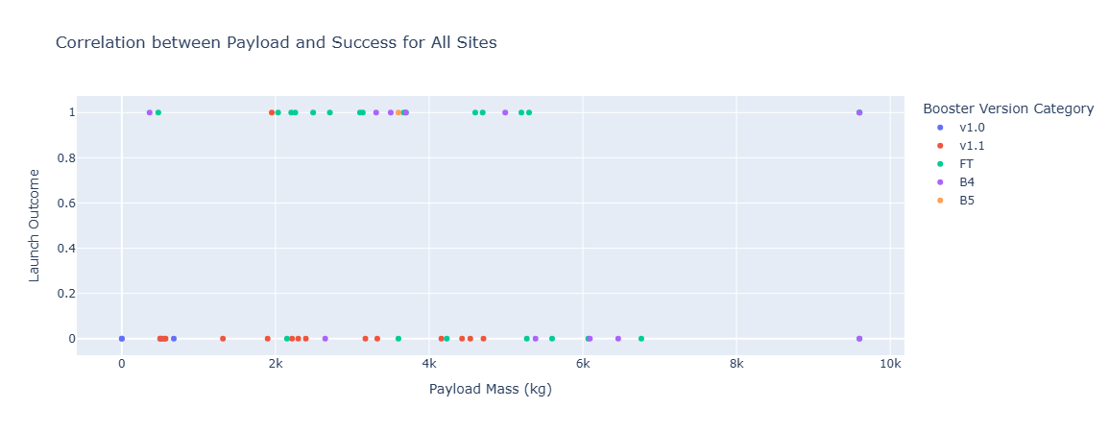
Correlation be Payload and Success
FT has the highest Success Rate
V1.1 has the lowest Success Rate

Slide 43

Section 5

Slide 44
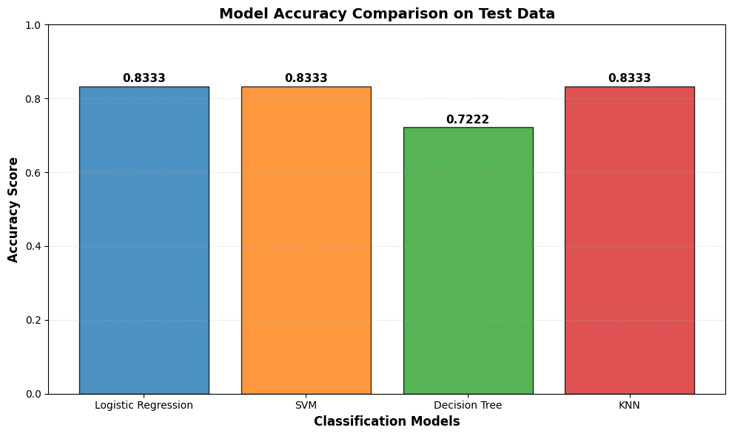
Classification Accuracy

Slide 45

Confusion Matrix
True Negatives (TN): 3 - Correctly predicted failures
False Positives (FP): 3 - Incorrectly predicted success (actual failures)
False Negatives (FN): 0 - No missed successful landings
True Positives (TP): 12 - Correctly predicted successes

Slide 46
Conclusions
Model Performance - 83.33% accuracy with Logistic Regression recommended
Overall Success Rate - 66.67% reusability demonstrating mature technology
Landing Methods - Drone ships dominate (68%) for operational flexibility
Model Strengths/Weaknesses - Perfect recall but some false positive bias
Historical Evolution - Technology maturation from 39% to 80%+ success
Payload Correlation - Heavy payloads require drone ships, optimal range 4-6 tons
NASA Integration - 22 missions from KSC with 167+ tons delivered
Business Impact - Enables competitive cost analysis for alternate launch providers

Slide 47
Appendix
All Notebooks, code and work product can be found here
https://github.com/mnem0nic7/adsc

Slide 48


